Slide 1
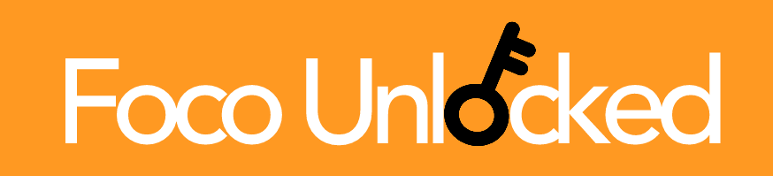
Foco Unlocked A mobile application for Foco diners to share their unique food combinations and find inspiration in others’ creations.
Madison Minsk ’19, Ijemma Onwuzulike ’19, Shirley Zhang ‘19

Slide 2
The Foco Problem
Foco has a large selection of food items, but this assortment remains largely stagnant from day to day and term to term
Students have developed ways of combining pre-made food items and ingredients, from pesto and chicken in the stir fry station, to Foco cookie sandwiches
We lack a platform for these students to connect and share their ideas with others

Slide 3
General Application Specifications
Two main pages:
An upload page- diners can add a photo of their meal with a short description of ingredients
The home page- displays the top food combinations of the day as determined by other diners up-voting combinations they like
Users can tap on the meal photos to leave a review or find out more information
Users will be ranked based upon how many up-votes their meals receive, enabling browsers to see a “top chef’s” most popular meals

Slide 4
Stakeholders
All Foco diners will be able to browse and upload on the application, after making an account
Freshman vs. Seniors
Freshman can use the app to familiarize themselves with a brand new dining space, learning interesting food combinations and being inspired to try some of their own instead of relying solely on the pre-made meals.
Seniors can use the app to share their Foco knowledge they have built over their Dartmouth careers, either the combinations they have come up with, or what they themselves have learned from upperclassmen.

Slide 5
Timeline
Design
March 5: Detailed final designs completed
Develop
March 23: Front end completed
April 4: Authentication, photo storage, back-end completed
April 4-14: Conduct user testing
April 14: Consolidate user testing results, evaluation
Deliver
April 15: Presentation

Slide 6
Progress
Completed design phase
Finalized designs for each page of the application
Began front end and back end development

